Slide 1

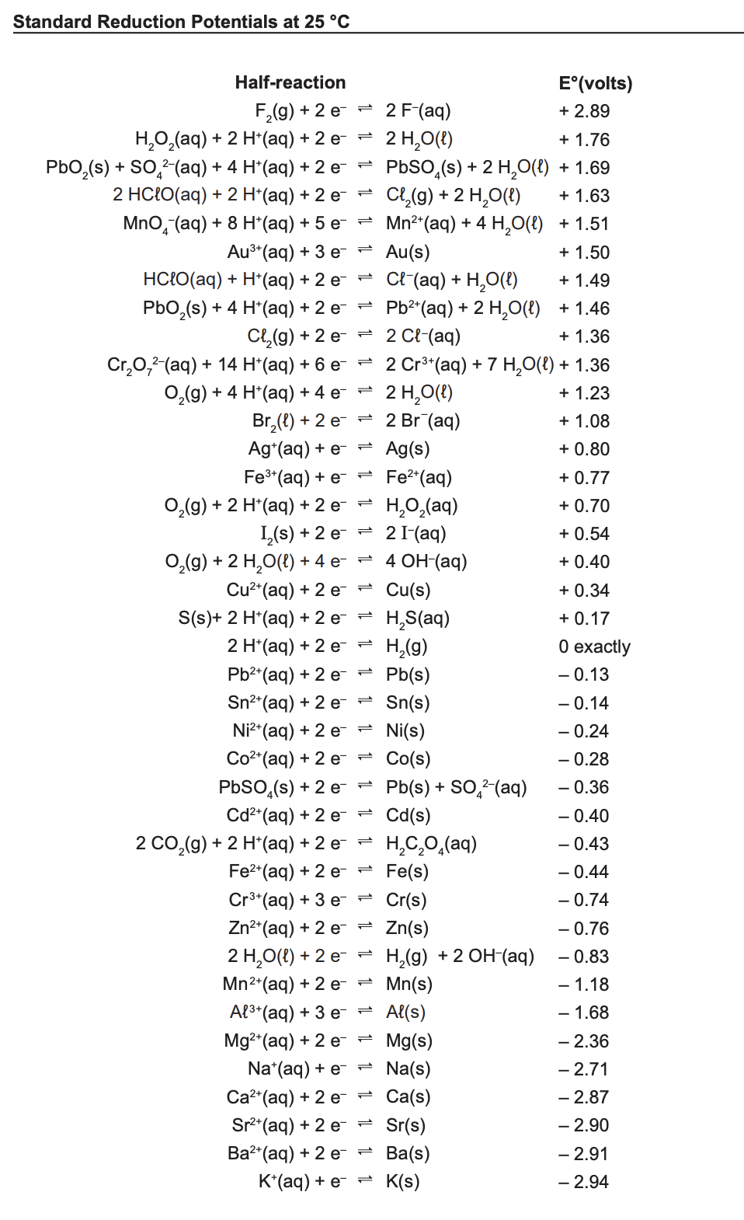
Oxidation and Reduction
Is an electron transfer reaction
Notes:
Today we are learning how to balance oxidation reduction equations using half equations. On the right is an image of the standard reduction Potentials, we will use this table extensively,so become familiar with it.

Slide 2
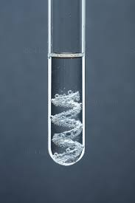
Oxidation-Reduction. (Redox)
Involves a change in oxidation number
Zinc metal placed in 1 mol L⁻¹ HCl
Zn_{(s)} + 2H⁺ _{(aq)} → Zn⁺²_{(aq)} + H_{2(g)} …………(1)
(oxidation numbers)
0
+1
+2
0
Redox reaction
….change in ox nos.
Notes:
Lets look at an acid and a metal reaction
redox reaction that is more gradual
cu agno3

Slide 3
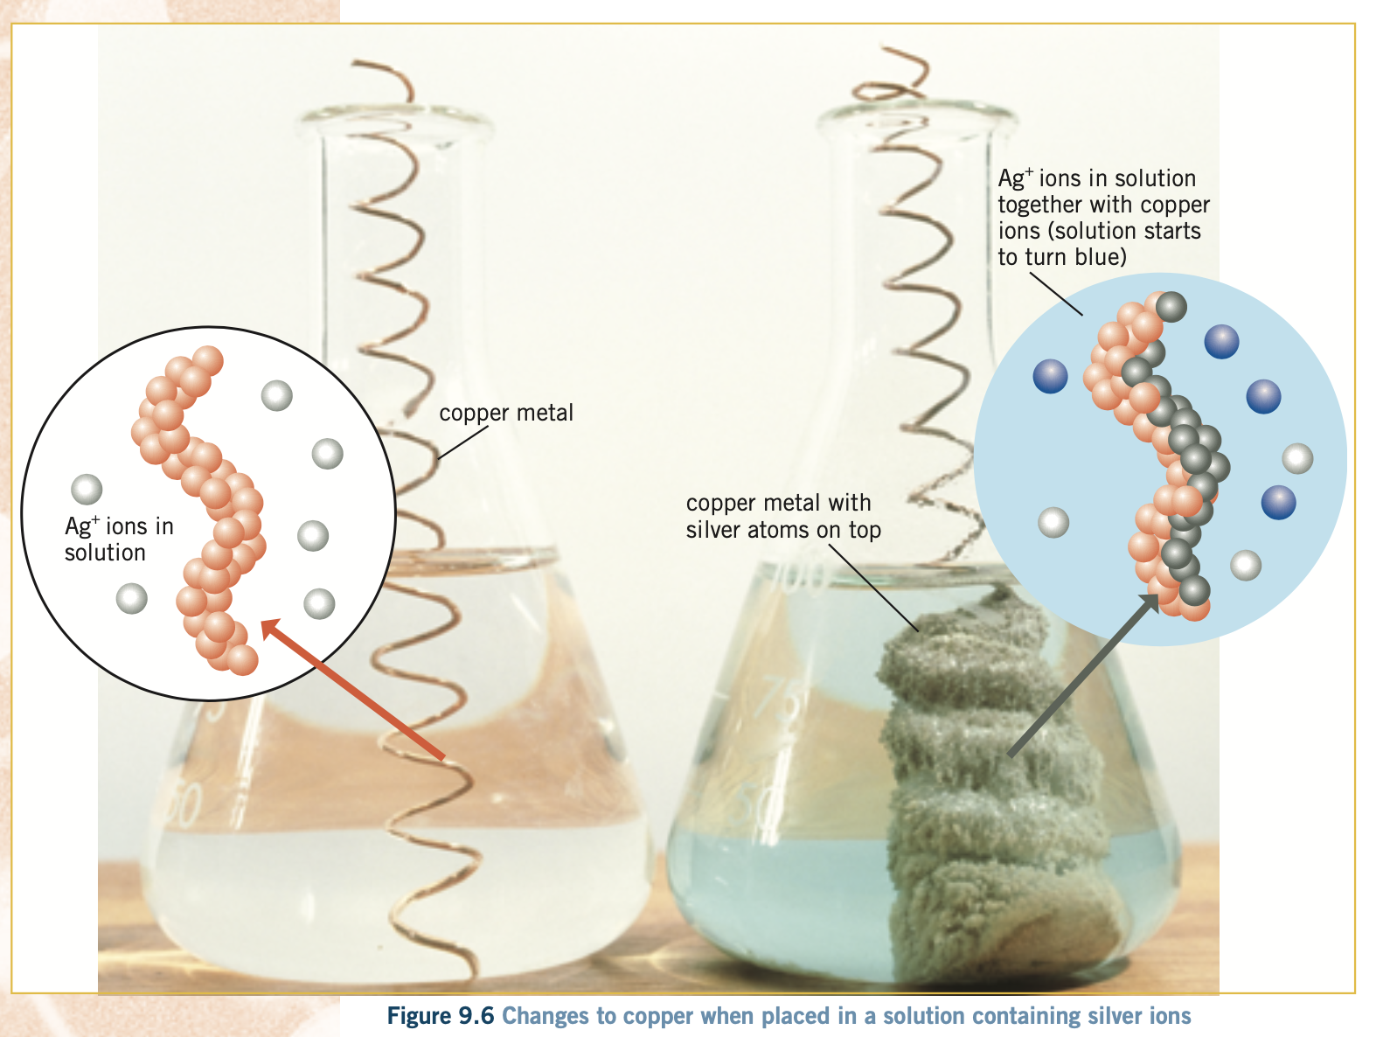
Oxidation –Reduction (Redox)
Copper wire placed in a silver nitrate solution (metal displacement reaction)
Oxidation and reduction occur simultaneously
Ionic equation(spectator ions omitted)
Cu_{(s)} + Ag⁺_{(aq)} →
2
+ Ag_{(s)}
Cu⁺²_{(aq)}
2
Notes:
This is an example of a reaction which occurs more slowly,
the change is shown by before and after images

Slide 4
Using Half-Equations
To balance a redox reaction
1
Write separate oxidation and reduction half–equations.
2
Use those to balance the overall reaction

Slide 5
Writing The Half-Equations
Show the species oxidized or reduced
H⁺_{(aq)} → H_{2(g)}
Balance atoms
Balance charge
Try this one
Cl_{2(g)} → Cl⁻ _{(aq)}
2
+ 2e⁻
reduction
( add e⁻ to the more positive side)
2
reduction
+ 2e⁻
Slightly harder examples →
Notes:
The reverse reactions would be oxidations

Slide 6
Writing a polyatomic ion, half-equations ( Acidic conditions)
How to balance, this half-reaction:
Cr₂O₇²⁻_{(aq)} → Cr³⁺_{(aq)}
Oxid number of Cr goes from +6 to +3
(Cr⁺⁶ is reduced(gains electrons))
Step 1: Balance atoms:
Cr₂O₇²⁻ _{(aq)} → 2Cr³⁺_{(aq)}
+ 14H⁺_{(aq)}
+ 6e⁻
+ 7H₂O _{(l)}
……..reduction
i). Balance O by adding H₂O to the equation
water is consumed or produced in these reactions
ii). Balance H by adding H⁺ to the equation
H⁺ ions are used or produced in these reactions:
Step 2: Balance charge:
Finally………………….Check that the atoms and the total charge balances
Notes:
These reactions can be balanced in alkali, these reactions contain OH- ions instead of H+, you may see some of these, but you won’t be required to ba;lance using OH- ions.

Slide 7
Half-Equations
Try this one
IO₃⁻_{(aq)} → I_{2(s)}
Balance atoms
IO₃⁻_{(aq)} → I_{2(s)}
Balance oxygen
Balance hydrogen
Balance charge
+ 12H⁺_{(aq)}
2
+ 10e⁻
+ 6H₂O _{(l)}
……..reduction
add water to the side deficient in oxygen
add H⁺ to balance hydrogens
add e⁻
Balancing the whole reaction using the half-equations →

Slide 8
Balancing the half-equations, to write the overall equation
Al_{(s)} + HCl_{(aq)}
Example: Dilute hydrochloric acid is added to some aluminium metal in a test tube.
Step 1. Write the oxidation and reduction half-equations.
oxidation of a metal by a H⁺ ion
Al_{(s)} → Al³⁺_{(aq)} + 3e-
oxidation
( ) x 2
2H⁺_{(aq)} + 2e- → H_{2(g)}
( ) x 3
reduction
2Al_{(s)} + 6H⁺_{(aq)} →
2 Al³⁺_{(aq)} + 3H_{2(g)}
redox
Step 2. Multiply each half-equation, by the smallest number, that will cancel the electrons from the overall redox equation.
Step 3. Add up the two half-equations and cancel out any common species.

Slide 9
Harder Examples: Essent Chem Set 9 Q. 4(f)
+7
Tl⁺_{(aq)} + MnO₄⁻ _{(aq)} + H⁺ _{aq)} → Mn²⁺ _{(aq)} + H₂O _{(l)} + Tl³⁺_{(aq)}
Look for species that have changed their oxid. nos
( ) x 5
Balance charge
oxidation
+ 2e⁻
Tl⁺_{(aq)} →. Tl³⁺_{(aq)}
+ 8H⁺_{(aq)}
MnO₄⁻ _{(aq)} → Mn²⁺ _{(aq)}
reduction
+ 5e-
+ 4H₂O_{(l)}
( ) x 2
Balance atoms
2MnO₄⁻ _{(aq)} + 5Tl⁺_{(aq)} + 16H⁺_{(aq)} → 2 Mn²⁺_{(aq)} + 8H₂O_{(l)}. + 5Tl³⁺_{(aq)}
Balance charge
redox
Balance half-equations then combine

Slide 10
Important to note
You ‘ll find these half–reactions in the chem data sheet
reductions
oxidations
Reverse direction for oxidation
Cl_{2(g)} + 2e⁻ → 2 Cl⁻ _{(aq)}
Cr₂O₇²⁻_{(aq)} + 14H_{(aq)} + 6e⁻ → 2Cr³_{(aq)} + 7H₂O_{(l)}
Ag⁺_{(aq)} + e⁻ → Ag_{(s)}
2H⁺_{(aq)} + 2e- → H_{2(g)}
Cu_{(s)} → Cu²⁺_{(aq)} + 2e⁻
H⁺ reacted with Al_{(s)}
Ag⁺ reacted with Cu_{(s)}
Al_{(s)} → Al³⁺_{(aq)} + 3e-

